Slide 1
Chapter 3: Set Theory
謝孫源 講座教授
hsiehsy@mail.ntcku.edu.tw
國立成功大學 資訊工程系

Slide 2
Outline
Sets and Subsets
Set Operations and the Laws of Set Theory
Counting and Venn Diagrams
A First Word on Probability

Slide 3
Sets and Subsets (1/3)
Set: A well-defined collection of objects. These objects are called elements and are said to be members of the set.
We use capital letters, such as A, B, C, …, to represent sets and lowercase letters to represent elements.
For a set A we write x ∈ A if x is an element of A; y ∉ A indicates that y is not a member of A.

Slide 4
Sets and Subsets (2/3)
Example 3.1: A set can be designated by listing its elements within set braces. For example, if A is the set consisting of the first five positive integers, then we write A = {1, 2, 3, 4, 5}. Here
2 ∈ A but 6 ∉ A.
Another standard notation: A = {x | x is an integer and 1 ≤ x ≤ 5}.
Notes:
|: “such that”
{x | …}: “the set of all x such that …”

Slide 5
Sets and Subsets (3/3)
Example 3.2: For U = {1, 2, 3, …}, the set of positive integers, Let
a) A = {1, 4, 9, …, 64, 81} = {x² | x ∈ U, x² < 100} = {x² | x ∈ U ∧ x² < 100}.
b) B = {2, 4, 6, 8, …} = {2k | k ∈ U}.
U: universe, or universe of discourse
A: finite set, B: infinite set
|A|: the number of elements in A and is referred to as the cardinality, or size. |A| = 9.

Slide 6
Subset and Proper Subset
Definition 3.1: If C, D are sets from a universe U, we say that C is a subset of D and write C ⊆ D, or D ⊇ C, if every element of C is an element of D. If, in addition, D contains an element that is not in C, then C is called a proper subset of D, and this is denoted by C ⊂ D or D ⊃ C.
For all subsets C, D of U, C ⊂ D ⇒ C ⊆ D
When C, D are finite, C ⊆ D ⇒ |C| ≤ |D|, and
C ⊂ D ⇒ |C| < |D|

Slide 7
Set Equality
Definition 3.2: For a given universe U, the sets C and D (taken from U) are said to be equal, and we write C = D, when C ⊆ D and D ⊆ C.
Neither order nor repetition is relevant for a general set, i.e., {1, 2, 3} = {3, 1, 2} = {2, 2, 1, 3} = {1, 2, 1, 3, 1}.

Slide 8
Example (1/2)
Example 3.5: Let U = {1, 2, 3, 4, 5, 6, x, y, {1, 2}, {1, 2, 3}, {1, 2, 3, 4}} (where x, y are the 24th, 25th lowercase letters of the alphabet and do not represent anything else, such as 3, 5, or {1, 2}). Then |U| = 11.
If A={1, 2, 3, 4}, then |A|=4 and here we have
i) A ⊆ U;
iv) {A} ⊆ U;
ii) A ⊂ U;
v) {A} ⊂ U;
iii) A ∈ U;
vi) {A} ∉ U.

Slide 9
Example (2/2)
Example 3.5 (cont.): A = {1, 2, 3, 4}
Now let B = {5, 6, x, y, A} = {5, 6, x, y, {1, 2, 3, 4}}. Then |B| = 5, not 8. And now we find that
i) A ∈ B;
ii) {A} ⊆ B;
iii) {A} ⊂ B.
But
iv) {A} ∉ B;
v) A ⊆ B (that is, A is not a subset of B); and
vi) A ⊄ B (that is, A is not a proper subset of B).

Slide 10
Subset Relations
Theorem 3.1: Let A, B, C ⊆ U.
a) If A ⊆ B and B ⊆ C, then A ⊆ C.
b) If A ⊂ B and B ⊆ C, then A ⊂ C.
c) If A ⊆ B and B ⊂ C, then A ⊂ C.
d) If A ⊂ B and B ⊂ C, then A ⊂ C.
Proof: Read by yourself.

Slide 11
Example
Example 3.6: Let U = {1, 2, 3, 4, 5} with A = {1, 2, 3}, B = {3, 4}, and C = {1, 2, 3, 4}. Then the following subset relations hold:
a) A ⊆ C
b) A ⊂ C
c) B ⊂ C
d) A ⊆ A
e) B ⊆ A
f) A ⊄ A (that is, A is not proper subset of A)

Slide 12
Null Set
Definition 3.3: The null set, or empty set, is the (unique) set containing no elements. It is denoted by ∅ or { }.
|∅| = 0, but {0} ≠ ∅.
∅ ≠ {∅} because {∅} is a set with one element, namely, the null set.
Theorem 3.2: For any universe U, let A ⊆ U. Then ∅ ⊆ A, and if A ≠ ∅, then ∅ ⊂ A.
Proof. Read by yourself.

Slide 13
Power Set (1/2)
Definition 3.4: If A is a set from universe U, the power set of A, denoted P(A), is the collection (or set) of all subsets of A.
Example 3.8: For the set C = {1, 2, 3, 4}, P(C) = {Ø, {1}, {2}, {3}, {4}, {1, 2}, {1, 3}, {1, 4}, {2, 3}, {2, 4}, {3, 4}, {1, 2, 3}, {1, 2, 4} {1, 3, 4} {2, 3, 4}, C}.

Slide 14

Power Set (2/2)
For any finite set A with |A| = n ≥ 0, we find that A has 2^{n} subsets and that |P(A)| = 2^{n}. For any 0 ≤ k ≤ n, there are subsets of size k. Counting the subsets of A according to the number, k, of elements in a subset, we have the combinatorial identity
Notes:
2^{n}: 每個 element 都有『選』與『不選』兩種可能 (Subset 包含 empty set 和 set 本身)
C(n, k): n 個 elements 選 k 個來構成 subset

Slide 15
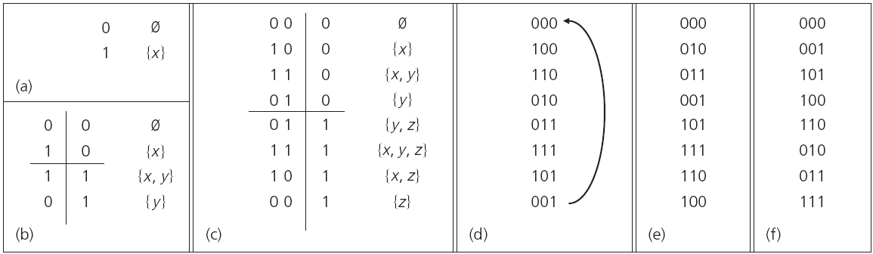
Gray Code
A systematic way to represent the subsets of a given nonempty set can be accomplished by using a coding scheme known as a Gray code.
Notes:
(b)左手邊是先(a), 再反向(a); 右手邊是先0, 再1
(c)左手邊是先(b), 再反向(b); 右手邊是先0, 再1
以此類推
➔ 每次只有一個 bit 的值改變

Slide 16
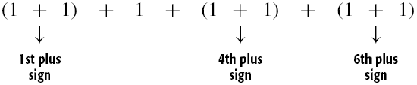
Example (1/3)
Example 3.11: Consider the composition of 7 as a sum of one or more positive integers, where the order of the summands is relevant.
For the set {1, 2, 3, 4, 5, 6} there are 2⁶ subsets. What does this have to do with the composition of 7?
Consider a subset {1, 4, 6}. This results in the composition 2 + 1 + 2 + 2.

Slide 17
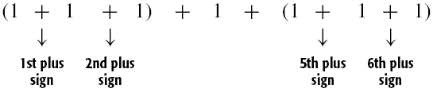
Example (2/3)
Example 3.11 (cont.):
The subset {1, 2, 5, 6} gives us the composition 3 + 1 + 3.
For each positive integer m, there are 2^{m–1} compositions of m.

Slide 18
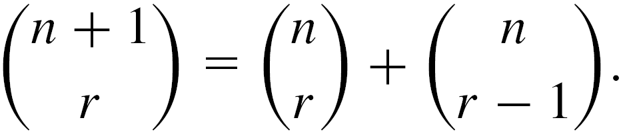
Example (3/3)
Example 3.12: For integers n, r with n ≥ r ≥1,
Hint: Let A = {x, a₁, a₂, …, a_{n}} and consider all subsets of A that contain r elements.
Notes:
只有兩種可能：包含x, 跟不包含x

Slide 19
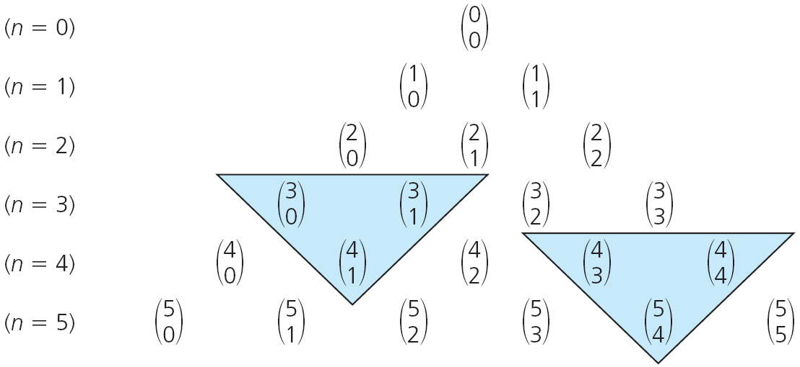
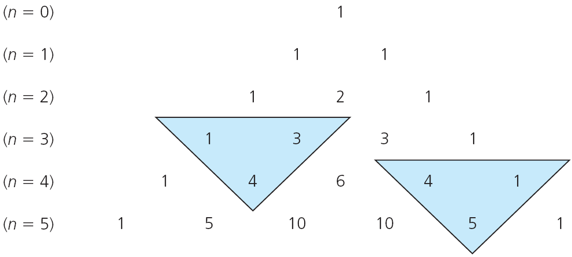
Pascal’s Triangle

Slide 20
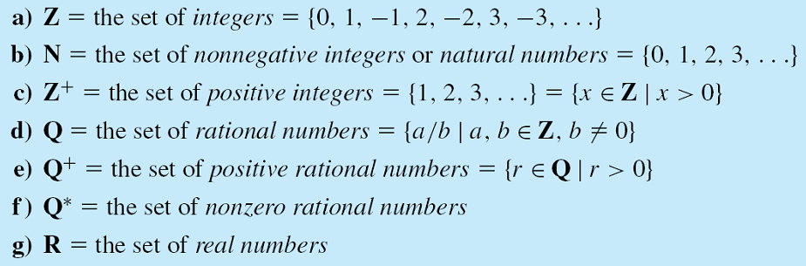
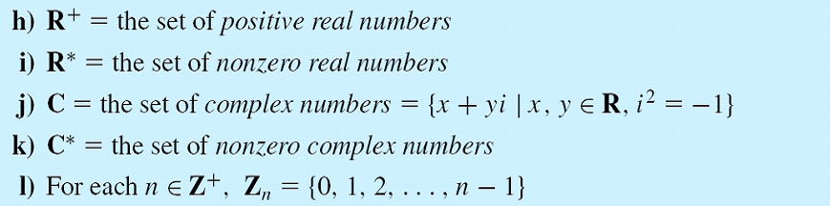
Set of Numbers
Notes:
Rational: 有理數

Slide 21
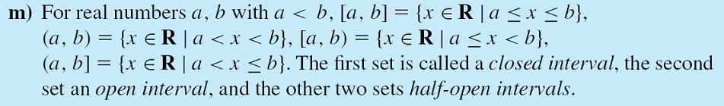
Set of Numbers
EXERCISES 3.1: 4, 12

Slide 22
Outline
Sets and Subsets
Set Operations and the Laws of Set Theory
Counting and Venn Diagrams
A First Word on Probability

Slide 23
Closed Binary Operations
The addition and multiplication of positive integers are said to be closed binary operations on Z⁺.
Two operands, hence the operation is called binary.
Since a + b ∈ Z⁺ when a, b ∈ Z⁺, we say that the binary operation of addition (on Z⁺) is closed.

Slide 24
Binary Operations for Sets
Definition 3.5: For A, B ⊆ U we define the following:
  A ∪ B (the union of A and B)
  = {x | x ∈ A ∨ x ∈ B}.
  A ∩ B (the intersection of A and B)
  = {x | x ∈ A ∧ x ∈ B}.
  A  B (the symmetric difference of A and B) = {x | (x ∈ A ∨ x ∈ B) ∧ x ∉ A ∩ B}
  = {x | x ∈ A ∪ B ∧ x ∉ A ∩ B}.

Slide 25
Example
Example 3.15: With U = {1, 2, 3,…, 9, 10}, A = {1, 2, 3, 4, 5}, B = {3, 4, 5, 6, 7}, and C = {7, 8, 9}, we have:
a) A ∩ B = {3, 4, 5}
b) A ∪ B = {1, 2, 3, 4, 5, 6, 7}
c) B ∩ C = {7}
d) A ∩ C = Ø
e) A  B = {1, 2, 6, 7}
f) A ∪ C = {1, 2, 3, 4, 5, 7, 8, 9}
g) A  C = {1, 2, 3, 4, 5, 7, 8, 9}

Slide 26
Disjoint (1/2)
Definition 3.6: Let S, T ⊆ U. The sets S and T are called disjoint, or mutually disjoint, when S ∩ T = Ø.
Theorem 3.3: If S, T ⊆ U, then S, T ⊆ U are disjoint if and only if S ∪ T = S  T.
Proof:
(Only if part) Consider each x ∈ U.
If x ∈ S ∪ T, then x ∈ S or x ∈ T.
∵ S, T disjoint ∴ x ∉ S ∩ T, so x ∈ S  T
∴ S ∪ T ⊆ S  T (1)

Slide 27
Disjoint (2/2)
Theorem 3.3 (cont.):
If y ∈ S  T, then y ∈ S or y ∈ T. So y ∈ S ∪ T.
∴ S  T ⊆ S ∪ T (2)
It follows from Definition 3.2 that S ∪ T = S  T.
(If part) (By contradiction) Assume S ∪ T = S  T and S ∩ T ≠ Ø. Then, let x ∈ S ∩ T.
Since x ∈ S and x ∈ T, x ∈ S ∪ T (= S  T)
But when x ∈ S ∪ T and x ∈ S ∩ T, then x ∉ S  T.
From this contradiction, we have S and T disjoint.

Slide 28
Complement
Definition 3.7: For a set A ⊆ U, the complement of A, denoted U – A, or A, is given by {x | x ∈ U ∧ x ∉ A}.
Definition 3.8: For A, B ⊆ U, the (relative) complement of A in B, denoted B – A, is given by {x | x ∈ B ∧ x ∉ A}.
Example 3.17: With U = {1, 2, 3,…, 9, 10}, A = {1, 2, 3, 4, 5}, B = {3, 4, 5, 6, 7}, and C = {7, 8, 9},
a) B – A = {6, 7}
d) C – A = C
b) A – B = {1, 2}
e) A – A = Ø
c) A – C = A
f) U – A = A

Slide 29
Subset, Union, Intersection, and Complement (1/4)
Theorem 3.4: For any universe U and any sets A, B ⊆ U, the following statements are equivalent:
a) A ⊆ B b) A ∪ B = B
c) A ∩ B = A d) B ⊆ A
Proof: In order to prove the theorem, we prove that (a) ⇒ (b), (b) ⇒ (c), (c) ⇒ (d), and (d) ⇒ (a).
(a) ⇒ (b) If A, B are any sets, then B ⊆ A ∪ B. For the opposite inclusion, if x ∈ A ∪ B, then x ∈ A or x ∈ B, but since A ⊆ B, in either case we have x ∈ B. So A ∪ B ⊆ B and, since we now have both inclusions, it follows that A ∪ B = B.

Slide 30
Subset, Union, Intersection, and Complement (2/4)
Theorem 3.4 (cont.) :
a) A ⊆ B b) A ∪ B = B
c) A ∩ B = A d) B ⊆ A
Proof:
(b) ⇒ (c) Given Sets A, B, we always have
A ⊇ A ∩ B. For the opposite inclusion, let y ∈ A. With A ∪ B = B, y ∈ A ⇒ y ∈ A ∪ B ⇒ y ∈ B (since A ∪ B = B) ⇒ y ∈ A ∩ B, so A ⊆ A ∩ B and we conclude that A = A ∩ B.

Slide 31
Subset, Union, Intersection, and Complement (3/4)
Theorem 3.4 (cont.) :
a) A ⊆ B b) A ∪ B = B
c) A ∩ B = A d) B ⊆ A
Proof:
(c) ⇒ (d) We know that z ∈ B ⇒ z ∉ B. Now if z ∈ A ∩ B, then z ∈ B, since A ∩ B ⊆ B. The contradiction — namely, z ∉ B ∧ z ∈ B — tells us that z ∉ A ∩ B. Therefore, z ∉ A because A ∩ B = A. But z ∉ A ⇒ z ∈ A, so B ⊆ A.

Slide 32
Subset, Union, Intersection, and Complement (4/4)
Theorem 3.4 (cont.) :
a) A ⊆ B b) A ∪ B = B
c) A ∩ B = A d) B ⊆ A
Proof:
(d) ⇒ (a) Last, w ∈ A ⇒ w ∉ A. If w ∉ B, then w ∈ B. With B ⊆ A it then follows that w ∈ A. This time we get the contradiction w ∉ A ∧ w ∈ A, and this tells us that w ∈ B. Hence A ⊆ B.

Slide 33
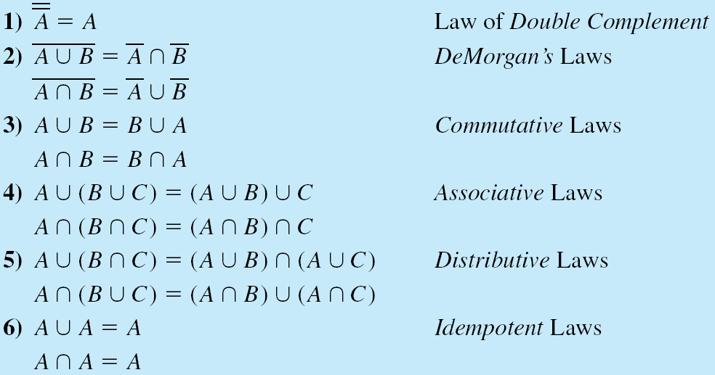
The Laws of Set Theory (1/2)
For any sets A, B, and C taken from a universe U

Slide 34
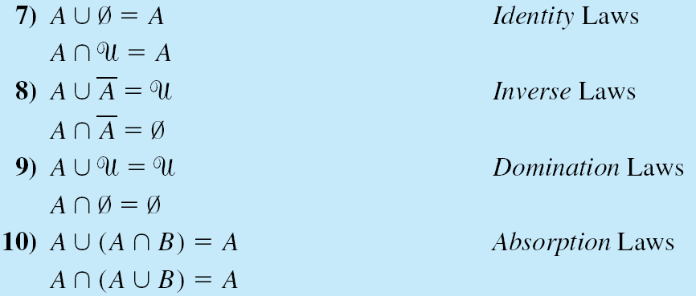
The Laws of Set Theory (2/2)

Slide 35
Dual
Definition 3.9: Let s be a (general) statement dealing with the equality of two set expressions. Each such expression may involve one or more occurrences of sets (such as A, A, B, B, etc.), one or more occurrences of Ø and U, and only the set operation symbols ∩ and ∪. The dual of s, denoted s^{d}, is obtained from s by replacing (1) each occurrence of Ø and U (in s) by U and Ø, respectively; and (2) each occurrence of ∩ and ∪ (in s) by ∪ and ∩, respectively.

Slide 36
The Principle of Duality
Theorem 3.5: Let s denote a theorem dealing with the equality of two set expressions (involving only the set operations ∩ and ∪ as described in Definition 3.9). Then s^{d}, the dual of s, is also a theorem.
This result cannot be applied to particular situations but only to results (theorems) about sets in general.
Example: U = {1, 2, 3, 4, 5}, A = {1, 2, 3, 4}, B = {1, 2, 3, 5}, C = {1, 2}, and D = {1, 3,}
A ∩ B = C ∪ D, but A ∪ B ≠ C ∩ D
Notes:
必須 for any sets A, B, C, and D taken from a universe U 都成立才行

Slide 37
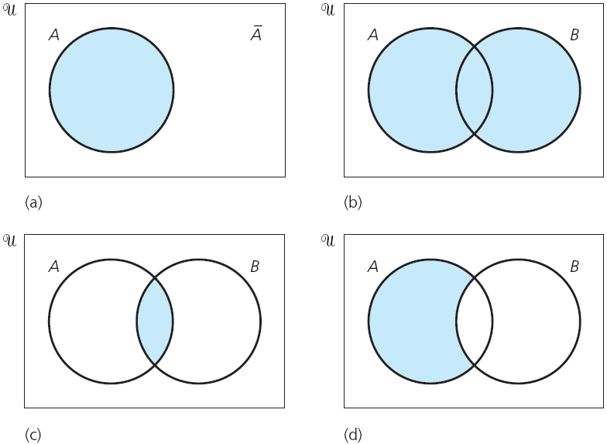
Venn Diagram (1/3)
A ∪ B
A ∩ B
A – B
Notes:
U is depicted as the interior of a rectangle, while subsets of U are represented by the interiors of circles and other closed curves.

Slide 38
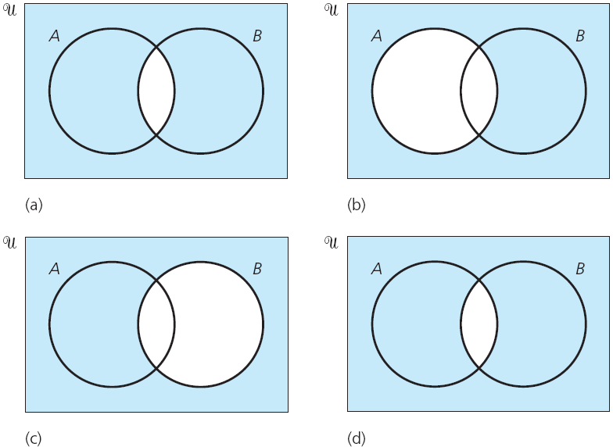
Venn Diagram (2/3)
A ∩ B
A
B
A ∪ B

Slide 39
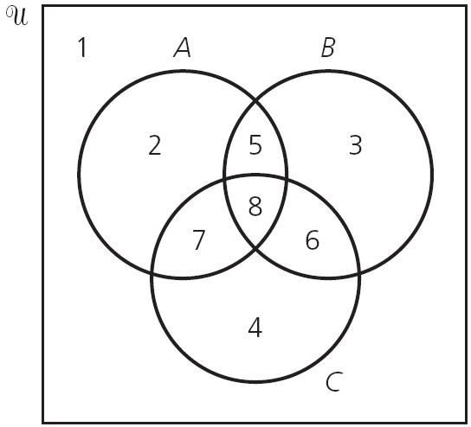
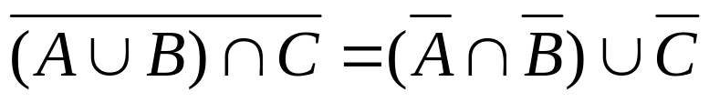
Venn Diagram (3/3)

Slide 40
Membership Table (1/3)
We observe that for sets A, B ⊆ U, an element x ∈ U satisfies exactly one of the following four situations:
a) x ∉ A, x ∉ B b) x ∉ A, x ∈ B
c) x ∈ A, x ∉ B d) x ∈ A, x ∈ B
When x is an element of a given set, we write a 1 in the column representing that set in the membership table; when x is not in the set, we enter a 0.

Slide 41
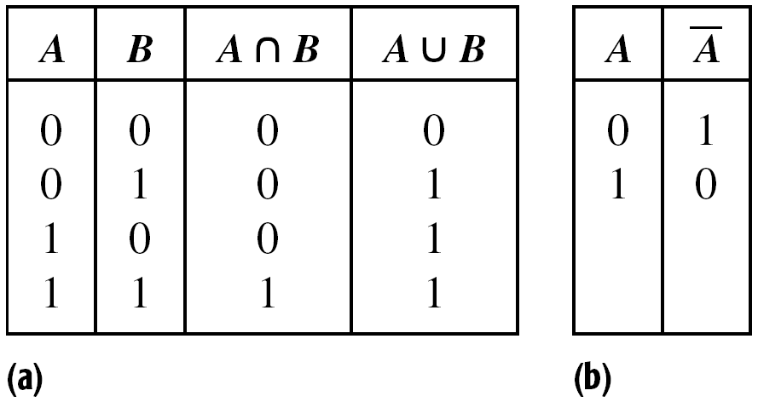
Membership Table (2/3)
Using membership tables, we can establish the equality of two sets by comparing their respective columns in the table.

Slide 42
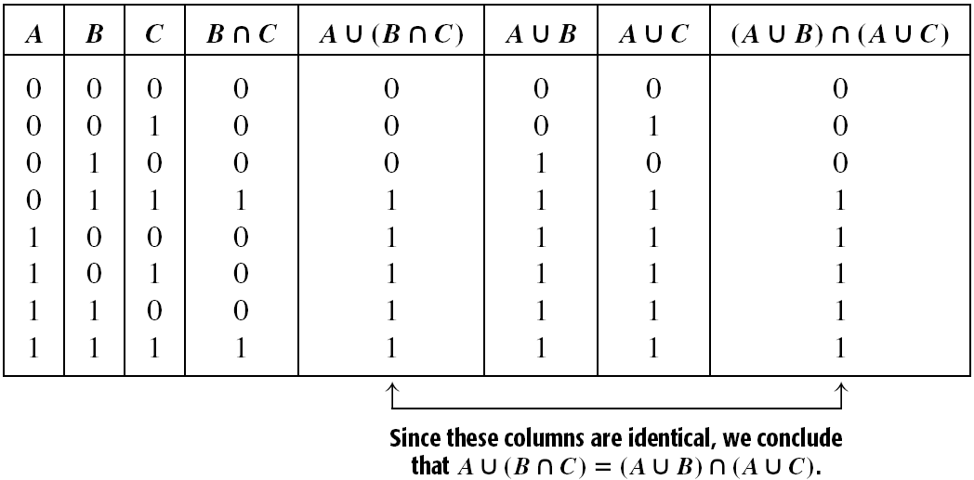
Membership Table (3/3)
Correspond with region 1: A ∩ B ∩ C

Slide 43

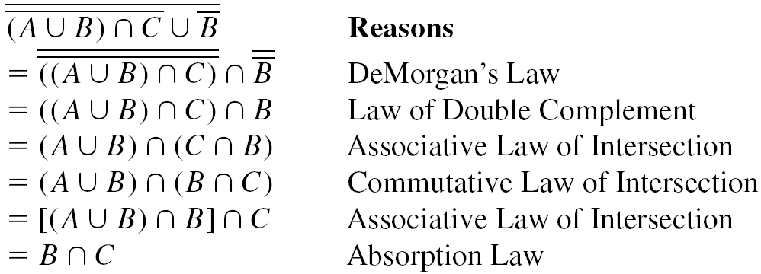
Simplify the Expression
Example 3.20: Simplify the expression

Slide 44
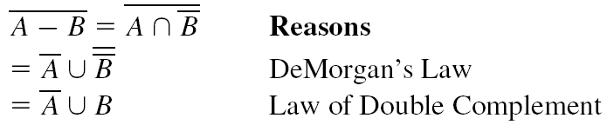
Example (1/3)
Example 3.21: Express A – B in terms of ∪ and .
From the definition of relative complement, A – B = {x | x ∈ A ∧ x ∉ B} = A ∩ B. Therefore,

Slide 45
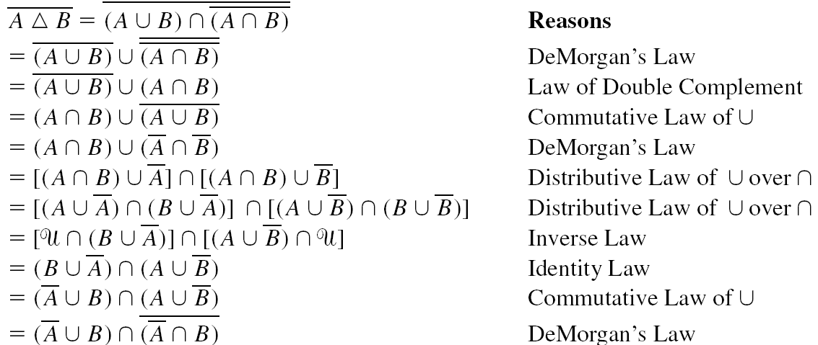
Example (2/3)
Example 3.22: We have A  B = {x | x ∈ A ∪ B ∧ x ∉ A ∩ B} = (A ∪ B) – (A ∩ B) = (A ∪ B) ∩ (A ∩ B), so

Slide 46
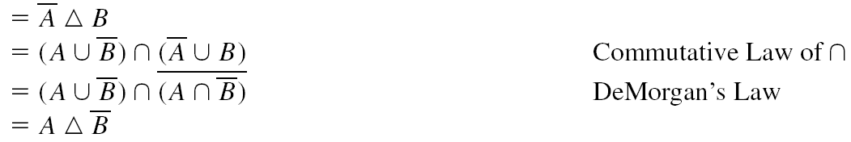
Example (3/3)
Example 3.22 (cont.):

Slide 47
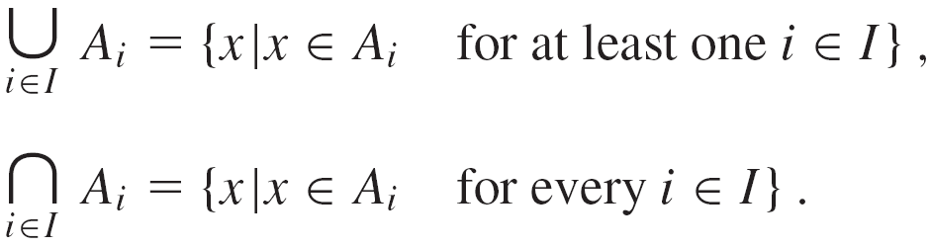
Index Set
Definition 3.10: Let I be a nonempty set and U a universe. For each i ∈ I let A_{i} ⊆ U. Then I is called an index set (or set of indices), and each i ∈ I is called an index.
Under these conditions,

Slide 48


Example
Example 3.23: Let I = {3, 4, 5, 6, 7}, and for each i ∈ I let A_{i} = {1, 2, 3,…, i} ⊆ U = Z⁺. Then
, whereas .
Example 3.24: Let U = R and I = R⁺. If for each r ∈ R⁺, A_{r} = [–r, r], then and .

Slide 49


Generalized DeMorgan’s Laws
Theorem 3.6: Generalized DeMorgan’s Laws. Let I be an index set where for each i ∈ I, A_{i} ⊆ U. Then
a) b)
EXERCISES 3.2: 2, 8

Slide 50
Outline
Sets and Subsets
Set Operations and the Laws of Set Theory
Counting and Venn Diagrams
A First Word on Probability

Slide 51
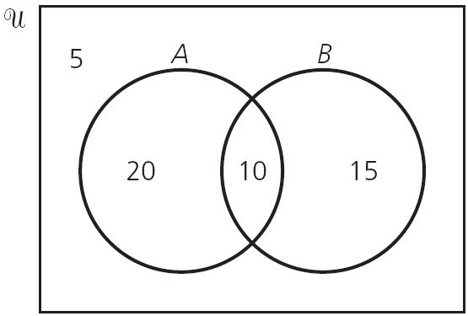
Counting Formulas (1/5)
Example 3.25: In a class of 50 college freshman, 30 are studying C++, 25 are studying Java, and 10 are studying both languages. How many freshman are studying either computer language?

Slide 52
Counting Formulas (2/5)
If A and B are finite sets, then |A ∪ B| = |A| + |B| – |A ∩ B|. Consequently, finite sets A and B are (mutually) disjoint if and only if |A ∪ B| = |A| + |B|. In addition, when U is finite, from DeMorgan’s Law we have |A ∩ B| = |A ∪ B| = |U| – |A ∪ B| = |U| – |A| – |B| + |A ∩ B|.

Slide 53
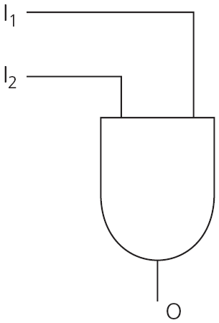
Counting Formulas (3/5)
Example 3.26: An AND gate in an ASIC (Application Specific Integrated Circuit) has two inputs: I₁, I₂, and one output: O. Such an AND gate can have any or all of the following defects:
D₁: The input I₁ is stuck at 0.
D₂: The input I₂ is stuck at 0.
D₃: The input O is stuck at 1.

Slide 54
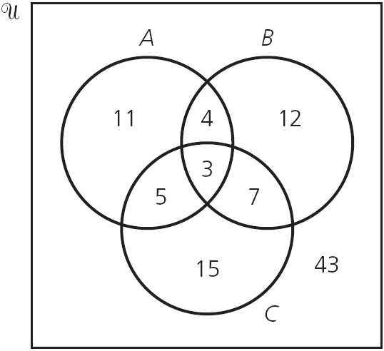
Counting Formulas (4/5)
Example 3.26 (cont.): For a sample of 100 such gates we let A, B, and C be the subsets (of these 100 gates) having defects D₁, D₂, and D₃, respectively. With
|A| = 23, |B| = 26,
|C| = 30, |A ∩ B| = 7,
|A ∩ C| = 8, |B ∩ C| = 10,
and |A ∩ B ∩ C | = 3,
how many gates in the
sample have at least
one of the defects
D₁, D₂, D₃?

Slide 55
Counting Formulas (5/5)
If A, B, C are finite sets, then |A ∪ B ∪ C| = |A| + |B| + |C| – |A ∩ B| – |A ∩ C| – |B ∩ C| + |A ∩ B ∩ C|. From the formula for |A ∪ B ∪ C| and DeMorgan’s Law, we find that if the universe U is finite, then |A ∩ B ∩ C| = |A ∪ B ∪ C| = |U| – |A ∪ B ∪ C| = |U| – |A| – |B| – |C| + |A ∩ B| + |A ∩ C| + |B ∩ C| – |A ∩ B ∩ C|.
EXERCISES 3.3: 10

Slide 56
Outline
Sets and Subsets
Set Operations and the Laws of Set Theory
Counting and Venn Diagrams
A First Word on Probability

Slide 57
Definition for Probability
Under the assumption of equal likelihood, let I be the sample space for an experiment E. Any subset A of I, including the empty subset, is called an event. Each element of I determines an outcome, so if |I| = n and a ∈ I, A ⊆ I, then
Pr({a}) = The probability that {a} (or, a) occurs
= |{a}|/I = 1/n, and
Pr(A) = The probability that A occurs = |A|/|I| = |A|/n.
[Note: We often write Pr(a) for Pr({a}).]
Notes:
When one performs an experiment, a set of all possible outcomes for each situation is called a sample space.

Slide 58
Example (1/4)
Example 3.29: If Dillon rolls a fair die, what is the probability he gets (a) a 5 or a 6, (b) an even number?
The sample space I = {1, 2, 3, 4, 5, 6}.
In part (a) we have event A = {5, 6} and
Pr(A) = 1/3.
For part (b) we consider event B = {2, 4, 6} and find that Pr(B) = 1/2.
Furthermore we also notice here that
Pr(A) = Pr({1, 2, 3, 4}) = 4/6 = 1 – 1/3 = 1 – Pr(A).

Slide 59
Example (2/4)
Example 3.30: There are 20 students enrolled in Mrs. Arnold’s class. Hence, if she wants to select two of her students, at random, to take care of the class rabbit, she may make her selection in C(20, 2) = 190 ways, so |I| = 190. Now suppose that Kyle and Kody are two of the 20 students in the class and we let A be the event that Kyle is one of the students selected and B be the event that the selection includes Kody. Consequently, upon choosing the students, at random, the probability that Mrs. Arnold selects

Slide 60
Example (3/4)
Example 3.30 (cont.):
a) both Kyle and Kody is
b) neither Kyle nor Kody is
c) Kyle but not Kody is

Slide 61
Example (4/4)
Example 3.31: Consider drawing five cards from a standard deck of 52 cards. This can be done in C(52, 5) = 2,598,960 ways. Now suppose that Tanya draws five cards, at random, from a standard deck. What is the probability she gets (a) three aces and two jacks; (b) three aces and a pair; (c) a full house (that is, three of one kind and a pair)?
(a) C(4, 3)C(4, 2)/C(52, 5)
(b) C(4, 3)C(12, 1)C(4, 2)/C(52, 5)
(c) C(13, 1)C(4, 3)C(12, 1)C(4, 2)/C(52, 5)

Slide 62
Cross Product (1/2)
Definition 3.11: For sets A, B, the Cartesian product, or cross product, of A and B is denoted by A × B and equals {(a, b) | a ∈ A, b ∈ B}.
Example 3.32: If A = {1, 2, 3} and B = {x, y}, then A × B = {(1, x), (1, y), (2, x), (2, y), (3, x), (3, y)} while B × A = {(x, 1), (x, 2), (x, 3), (y, 1), (y, 2), (y, 3)}. Here (1, x) ∈ A × B but (1, x) ∉ B × A, although (x, 1) ∈ B × A. So A × B ≠ B × A, but |A × B| = 6 = 2 ⋅ 3 = |A||B| = |B||A| = |B × A|.
Notes:
Cartesian:笛卡兒的;笛卡兒哲學的

Slide 63
Cross Product (2/2)
Example 3.35: If Charles tosses a fair coin four times, what is the probability that he gets two heads and two tails?
For this experiment of tossing a fair coin four times, we have the sample space I = I₁ × I₂ × I₃ × I₄, where I₁ = I₂ = I₃ = I₄ = {H, T}. |I| = 2⁴ = 16.
The event A we are concerned about contains all arrangement of H, H, T, T, so |A| = 4!/(2!2!) = 6.
Pr(A) = 6/16 = 3/8.
Notes:
Cartesian:笛卡兒的;笛卡兒哲學的

Slide 64
Concept of a Venn Diagram (1/2)
Example 3.37: In a survey of 120 passengers, an airline found that 48 enjoyed wine with their meals, 78 enjoyed mixed drinks, and 66 enjoyed iced tea. In addition, 36 enjoyed any given pair of these beverages and 24 passengers enjoyed them all. If two passengers are selected at random from the survey sample of 120, what is the probability that
a) (Event A) they both want only iced tea with their meals?
b) (Event B) they both enjoy exactly two of the three beverage offerings?
Notes:
Wine:葡萄酒;水果酒;酒
Mixed drink:混合雞尾酒

Slide 65
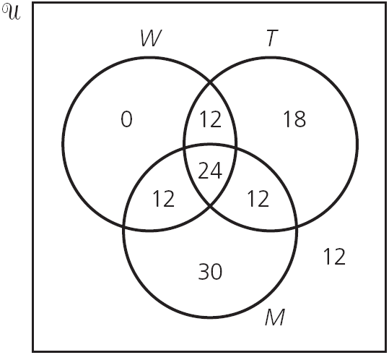
Concept of a Venn Diagram (2/2)
Example 3.37 (cont.):
Pr(A) = C(18, 2)/C(120, 2) = 51/2380
Pr(B) = 3/34

Slide 66
Homework Assignment #3
EXERCISES 3.1
4, 12
EXERCISES 3.2
2, 8
EXERCISES 3.3
10
EXERCISE 3.4
5, 8

